Slide 1
Instance Segmentation with Mask R-CNN

Slide 2
Faster R-CNN
Faster R-CNN consists of two stages. The first stage, called a Region Proposal Network (RPN), proposes candidate object bounding boxes. The second stage, which is in essence Fast R-CNN ,extracts features using RoIPool from each candidate box and performs classification and bounding-box regression. The features used by both stages are shared for faster inference

Slide 3
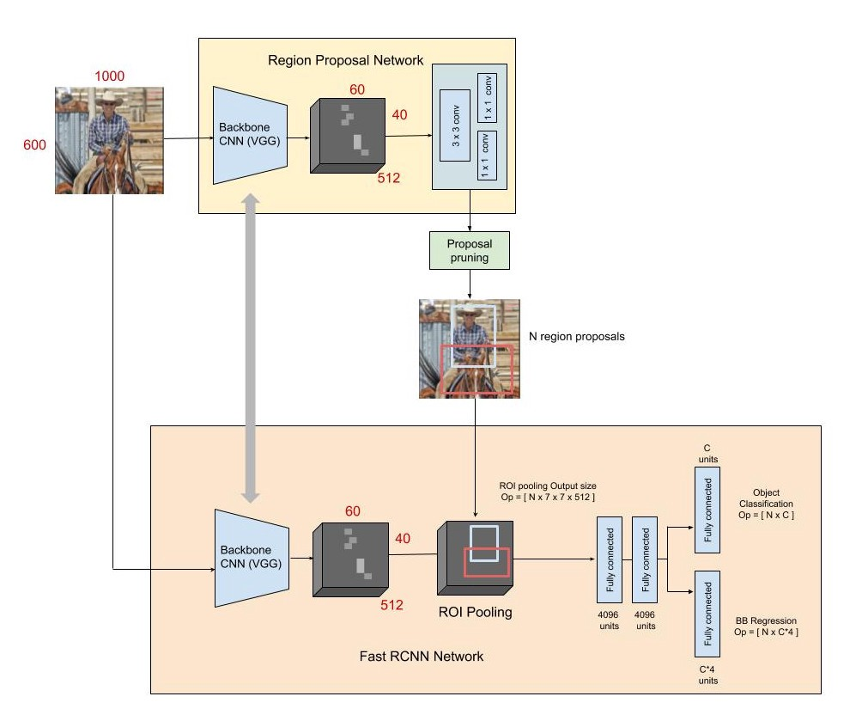

Slide 4
The Fast R-CNN consists of a CNN with its final pooling layer replaced by an “ROI pooling” layer and its final FC layer is replaced by two branches — a category softmax layer branch and a category-specific bounding box regression branch. The input images are represented as Height × Width × Depth tensors (multidimensional arrays), which are passed through a pre-trained CNN up until an intermediate layer, ending up with a convolutional feature map. We use this as a feature extractor for the next part. Depending on the backbone CNN used, the output feature maps are much smaller than the original image size. This depends on the stride of the backbone CNN. Next, we have what is called a Region Proposal Network (RPN). Using the features that the CNN computed, it is used to find up to a predefined number of regions (bounding boxes), which may contain objects. Generating bounding boxes are done using anchors which are fixed sized reference bounding boxes which are placed uniformly throughout the original image. For every point in the output feature map, the network has to learn whether an object is present in the input image at its corresponding location and estimate its size. This is done by placing a set of “Anchors” on the input image for each location on the output feature map from the backbone network. These anchors indicate possible objects in various sizes and aspect ratios at this location. The figure below shows 9 possible anchors in 3 different aspect ratios and 3 different sizes placed on the input image for a point A on the output feature map. The anchors used have 3 scales of box area 128², 256², 512² and 3 aspect ratios of 1:1, 1:2 and 2:1.

Slide 5
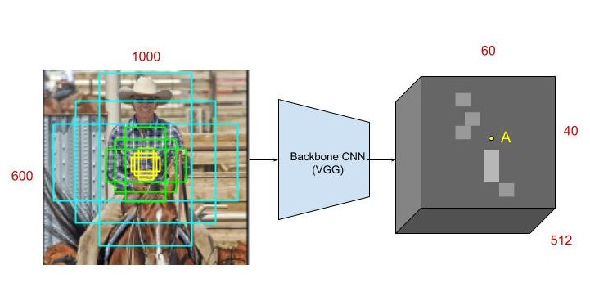

Slide 6
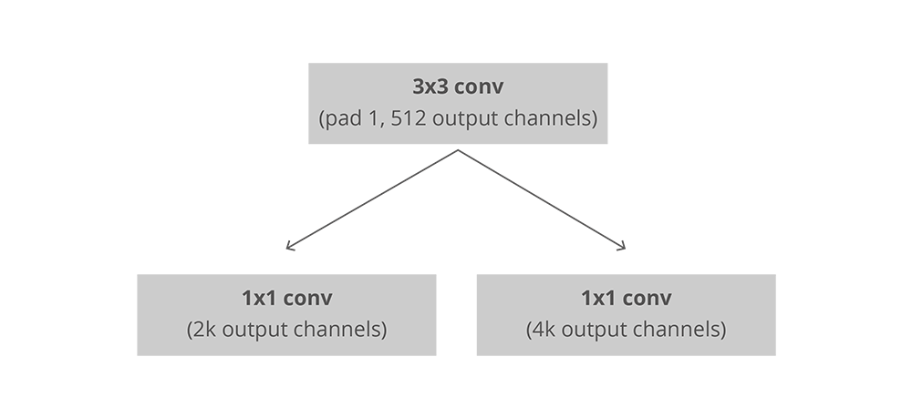
The RPN takes all the reference boxes (anchors) and outputs a set of good proposals for objects (object proposals are rectangular regions on the image that signify the presence of an object). It does this by having two different outputs for each of the anchors. The first one is the probability that an anchor is an object. The RPN doesn’t care what class of object it is, only that it does in fact look like an object (and not background). We are going to use this objectness score to filter out the bad predictions for the second stage. The second output is the bounding box regression for adjusting the anchors to better fit the object it’s predicting. The RPN is implemented efficiently in a fully convolutional way, using the convolutional feature map returned by the base network as an input. First, we use a convolutional layer with 512 channels and 3x3 kernel size and then we have two parallel convolutional layers using a 1x1 kernel, whose number of channels depends on the number of anchors per point.
For the classification layer, we output two predictions per anchor: the score of it being background (not an object) and the score of it being foreground (an actual object).For the regression, or bounding box adjustment layer, we output 4 predictions : ​ xcenter, ycenter, width, height which we will apply to the anchors to get the final proposals.

Slide 7
After the RPN step, we have a bunch of object proposals with no class assigned to them. Our next problem to solve is how to take these bounding boxes and classify them into our desired categories. The simplest approach would be to take each proposal, crop it, and then pass it through the pre-trained base network. Then, we can use the extracted features as input for image classifier. The main problem is that running the computations for all the 2000 proposals is really inefficient and slow. Faster R-CNN tries to solve, or at least mitigate, this problem by reusing the existing convolutional feature map. This is done by extracting fixed-sized feature maps for each proposal using region of interest pooling. Fixed size feature maps are needed for the R-CNN in order to classify them into a fixed number of classes. A simpler method, is to crop the convolutional feature map using each proposal and then resize each crop to a fixed sized 14×14×convdepth using interpolation (usually bilinear). After cropping, max pooling with a 2x2 kernel is used to get a final (7×7×convdepth) feature map for each proposal.

Slide 8
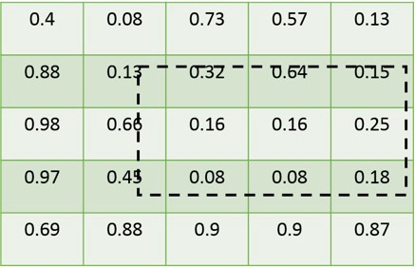
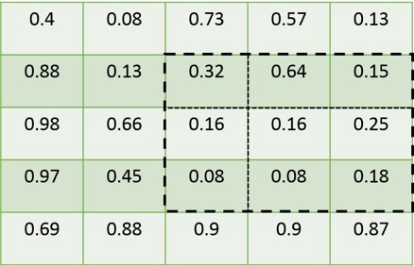
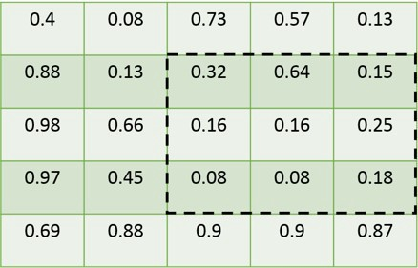
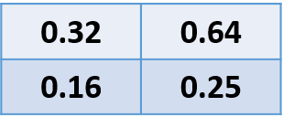
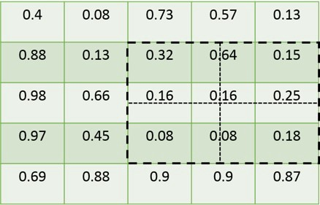
ROI Pooling:
Let’s assume a 5 X 5 feature map, with the ROI plotted on it. Notice that boundaries of ROI don’t coincide with the granularity of feature map (As ROI’s have coordinates w.r.t to original image, and feature map has a lower resolution than the input image).
To resolve the above mentioned issue, the boundaries of ROI are rounded off to match the granularity of the feature map. Now the boundaries of ROI align with that of the granularity of the feature map.
Depending on the output size (m) we mention, we get a m x m matrix, we divide the ROI into bins depending on the value of m. In this example, we have taken m=2. Notice that the boundaries of bins again don’t align with that of feature map.
We perform the quantization step again, similar to step 1. We apply max-pool operation in each bin separately. So the final four values in this example come out to be (0.32,0.64,0.16,0.25). We get the final m X m matrix for all the ROI’s.
(The Mask R-CNN research paper says that the position and number of sample points don’t matter so much.)
https://towardsdatascience.com/region-of-interest-pooling-f7c637f409af(refer this for detailed explanation of roi pooling)

Slide 9
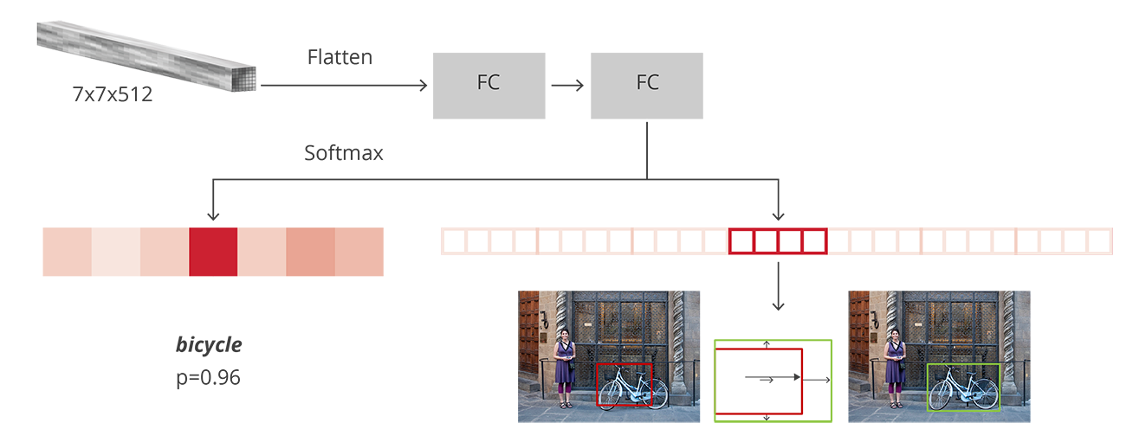
The output from the ROI pooling layer is passed through two fully connected layers, and then the features are fed into the sibling classification and regression branches. Note that these classification and detection branches are different from those of the RPN. Here the classification layer has C units for each of the classes in the detection task (including a catch-all background class). The features are passed through a softmax layer to get the classification scores — the probability of a proposal belonging to each class. The regression layer coefficients are used to improve the predicted bounding boxes. Here the regressor is size agnostic, (unlike the RPN) but is specific to each class. That is, all the classes have individual regressors with 4 parameters each corresponding to C*4 output units in the regression layer. In the original Faster R-CNN paper, the R-CNN takes the feature map for each proposal, flattens it and uses two fully-connected layers of size 4096 with ReLU activation. Then, it uses two different fully-connected layers for each of the different objects:
A fully-connected layer with N+1 units where NN is the total number of classes and that extra one is for the background class.
A fully-connected layer with 4N units. We want to have a regression prediction, thus we need Δ​center​x​​​​,Δ​center​y​​​​,Δ​width​​,Δ​height​​ for each of the N possible classes.

Slide 10
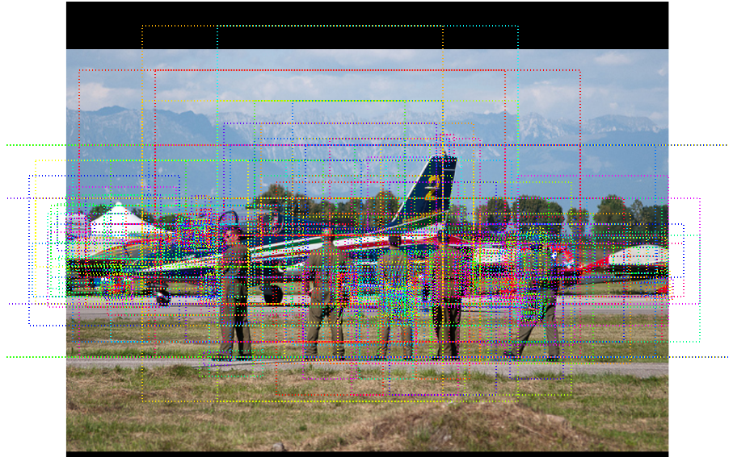
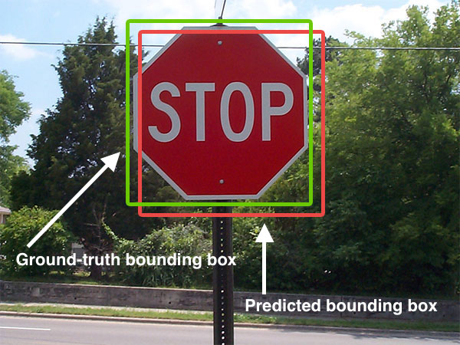

IOU
To predict multiple objects or multiple instances of objects in an image, Mask R-CNN makes thousands of predictions. Final object detection is done by removing anchor boxes that belong to the background class and the remaining ones are filtered by their confidence score. (i.e. IoU)
(ground truth box is training label and predicted is the box predicted from our model.)

Slide 11
An anchor is considered to be a “positive” sample if it satisfies either of the two conditions — a) The anchor has the highest IoU (Intersection over Union, a measure of overlap) with a groundtruth box; b) The anchor has an IoU greater than 0.7 with any groundtruth box. The same groundtruth box can cause multiple anchors to be assigned positive labels. An anchor is labeled “negative” if its IoU with all groundtruth boxes is less than 0.3. The remaining anchors (neither positive nor negative) are disregarded for RPN training.
For a typical 1000 × 600 image, there will be roughly 20000 (≈ 60 × 40 × 9) anchors in total. With the cross-boundary anchors ignored, there are about 6000 anchors per image for training. If the boundary-crossing outliers are not ignored in training, they introduce large, difficult to correct error terms in the objective, and training does not converge. During testing, however, we still apply the fully convolutional RPN to the entire image. This may generate cross boundary proposal boxes, which we clip to the image boundary. Some RPN proposals highly overlap with each other. To reduce redundancy, we adopt non-maximum suppression (NMS) on the proposal regions based on their class scores. We fix the IoU threshold for NMS at 0.7, which leaves us about 2000 proposal regions per image. As we will show, NMS does not harm the ultimate detection accuracy, but substantially reduces the number of proposals. After NMS, we use the top-N ranked proposal regions for detection

Slide 12
Training
RPN:
The RPN can be trained end-to-end by backpropagation and stochastic gradient descent (SGD) . We follow the “image-centric” sampling strategy from to train this network. Each mini-batch arises from a single image that contains many positive and negative example anchors. Sampling all the anchors from this image would bias the learning process toward negative samples, So 128 positive and 128 negative samples are randomly selected to form the batch, padding with additional negative samples if there are an insufficient number of positives. We randomly initialize all new layers by drawing weights from a zero-mean Gaussian distribution with standard deviation 0.01. All other layers (i.e., the shared convolutional layers) are initialized by pretraining a model for ImageNet classification . We can use a learning rate of 0.001 for 60k mini-batches, and 0.0001 for the next 20k mini-batches on the our dataset. We use a momentum of 0.9 and a weight decay of 0.0005 .
4 Step Alternating training
In order to force the network to share the weights of the CNN backbone between the RPN and the detector, the authors use a 4 step training method:
a)The RPN is trained independently as described above. The backbone CNN for this task is initialized with weights from a network trained for an ImageNet classification task, and is then fine-tuned for the region proposal task. b) The Fast R-CNN detector network is also trained independently. The backbone CNN for this task is initialized with weights from a network trained for an ImageNet classification task, and is then fine-tuned for the object detection task. The RPN weights are fixed and the proposals from the RPN are used to train the Faster R-CNN. c) The RPN is now initialized with weights from this Faster R-CNN, and fine-tuned for the region proposal task. This time, weights in the common layers between the RPN and detector remain fixed, and only the layers unique to the RPN are fine-tuned. This is the final RPN. d) Once again using the new RPN, the Fast R-CNN detector is fine-tuned. Again, only the layers unique to the detector network are fine-tuned and the common layer weights are fixed.
This gives a Faster R-CNN detection framework that has shared convolutional layers.

Slide 13
Mask R-CNN:
Mask rcnn is an extension of faster rcnn with an additional FC layer for generating segmentation mask
There are three major changes from faster R-CNN to mask R-CNN: 1. Use of FPN’s 2. Replacement of ROIPool with ROIAlign 3. Introduction of additional branch to generate masks.
In faster r-cnn we are using a backbone cnn network (such as resnet-50 or VGG)as a first step. But here in mask r–cnn instead of using cnn directly we integrate them with FPN
Another major change from faster -R-CNN would be replacement of ROI Pool with ROI Align. ROI Pool did work quite well in case of object detection, it involved coarse quantization steps, which rendered disastrous in case of generating mask predictions.

Slide 14
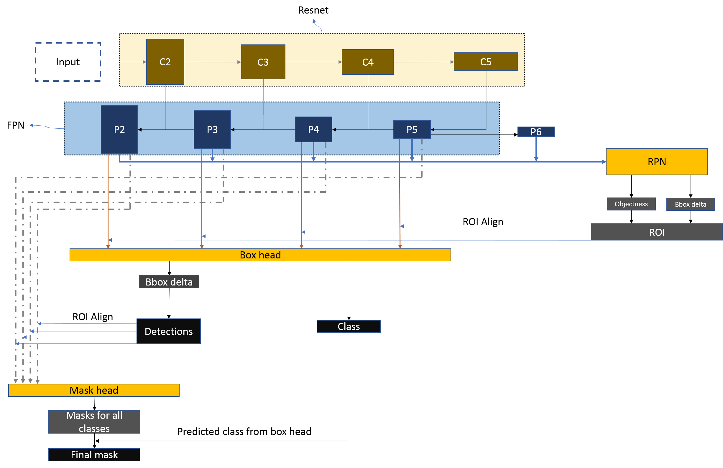

Slide 15
Stages:
FPN
RPN
ROI(Generation of propasals)(ROI align is applied to the output of this stage)
Box Head(Gives two outputs. One for predicted object class and other for bounding box regression values)
Detection(Gives final detections after applying NMS)(ROI align is applied to the output of this stage)
Mask Head(output from prevous stage and from FPN and classes from box head are passed to generate final masks)

Slide 16
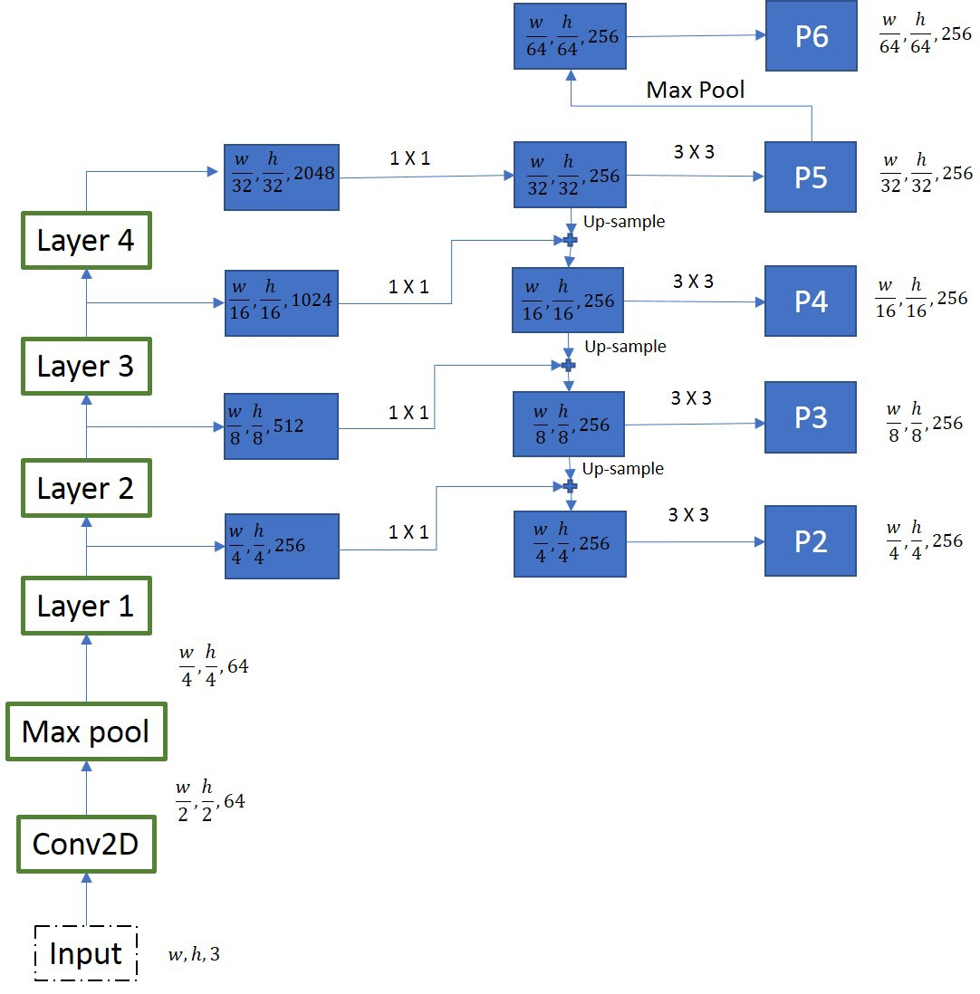
FPN:
At every layer the feature maps size is reduced by half and number of feature maps are doubled. We are extracting features from 4 feature maps from the resnet-50 architecture (layer-1, layer-2, layer-3, layer-4 outputs) as shown in the diagram. To generate final feature maps, we use an approach called top-bottom pathway. We start from the smallest feature map and work our way down to bigger ones, by upscale operations.In the diagram we can see that, the feature map generated by layer 2 is first subjected to 1 X 1 convolutions to bring down the number of channels to 256. This is then added element-wise to the up-sampled output from the previous iteration. All the outputs of this process are subjected to 3 X 3 convolution layer to create final 4 feature maps(P2, P3, P4,P5). The 5th feature map (P6) is generated from a max pooling operation from P5.
These P1,P2,P3,P4,P5,P6 are then passed to RPN

Slide 17
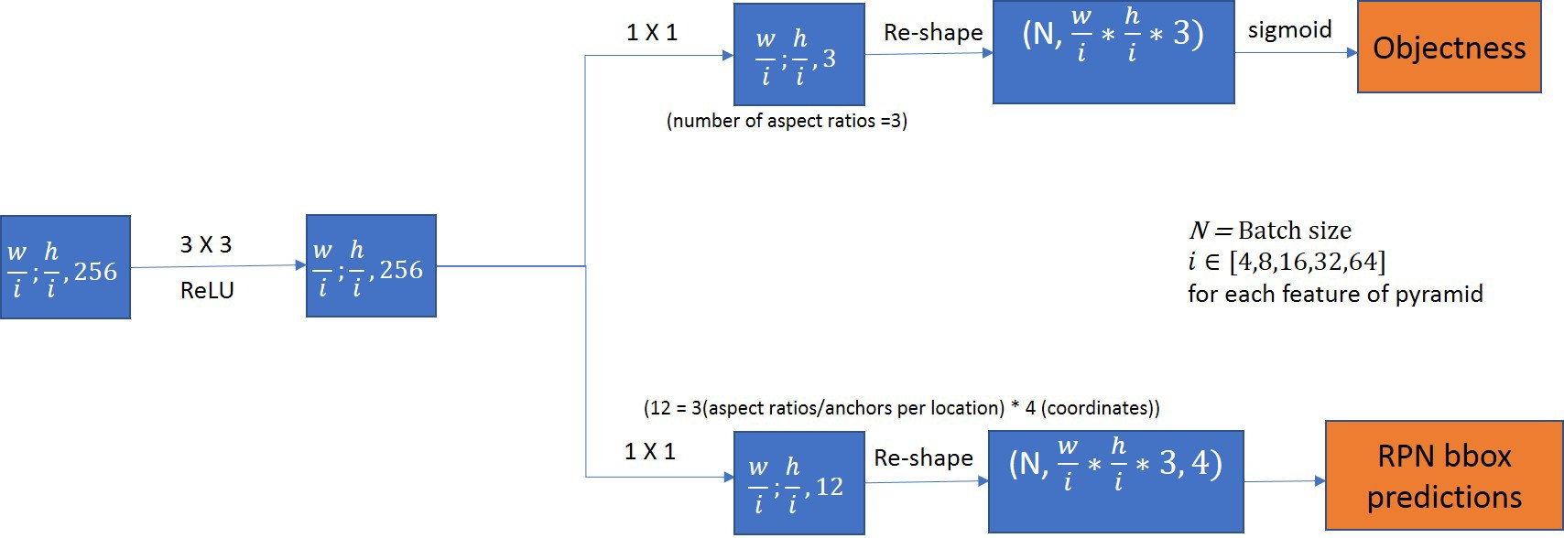
RPN:
It should be 3,2(2 classes : object or not)
Each of the feature maps generated is passed through a 3 X 3 convolution layer. The resulting output is passed to two branches, one pertaining to object scores and other to bounding box regressors. We only use only one anchor stride(scale) here for a feature pyramid (as we already have features of different sizes in pyramid to take care for objects of different sizes) and 3 anchor ratios. Hence 3*2 channels in objectness and 3*4 channels in bounding box regressor.
All anchor ratios and strides must be exactly same for training and testing, as the objectness scores and bounding box regressor channels correspond to the anchor ratios used during training.

Slide 18
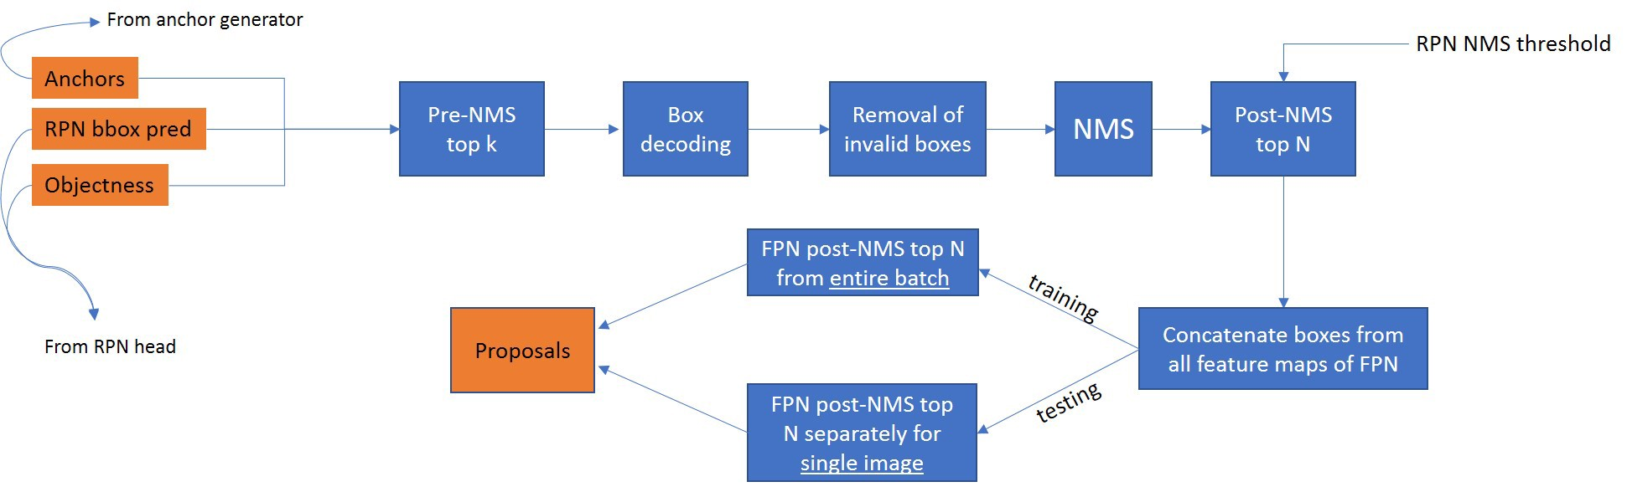
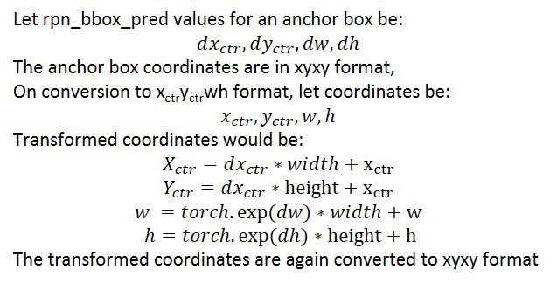
Generation of Proposals:
Box decoding: The anchor box coordinates are modified according to rpn_bbox_pred values obtained from RPN head.
Removal of invalid boxes: Remove the boxes in which either of coordinate lies outside the image, or images with negative height and width.
Concatenate: Steps 1–4 have been performed separately for each feature of pyramid generated by FPN backbone. In this step, All the anchor boxes are grouped together

Slide 19
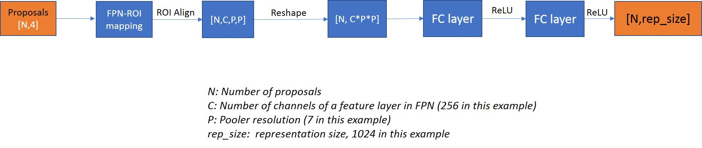
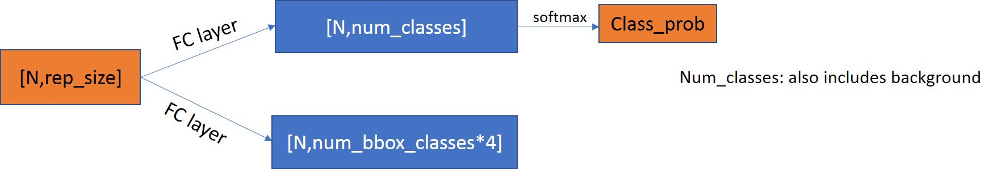
Box Head:
FPN-ROI mapping: The purpose of FPN-ROI mapping is to associate the appropriate feature map of FPN to a particular ROI based on its area. By mentioning pooler scales, we have the liberty to use less number of pooler scales if using ROI align on all feature maps doesn’t suit our purpose. Our FPN generates 5 feature maps, all 5 of them are used in RPN to generate proposals, However, only 4 (P2, P3, P4, P5) are used during while associating with ROI’s.
ROI Align: One of the most significant changes from faster-r-cnn would be replacement of ROI pooling with ROI align. Both the operations generate a uniform P X P matrix for all the ROI’s. ROI Pool works well in case of object detection, but fails terribly in case of instance segmentation, as we have too many quantization steps which affect generation of masks, where pixel to pixel correspondence matters. For now, let’s consider ROI Align/Pool gives a constant output of P X P irrespective of the proposal size
Fully connected layers: The output for each ROI is reshaped to be passed through a fully connected layer, for which the number of out channels is a hyper parameter called representation size(default:1024). This is passed through another FC layer with same number of in and out channels. We get different 1024 length vectors for all the ROI’s. The feature extracted here we have shown is for Resnet-50 FPN. This will change if use some different backbone, but overall, all use ROI Align and generate a output vector of same size for each ROI.
The ROI vectors are then passed through a predictor, containing 2 branches, each with a FC layer. One for predicting the object class and other for bounding box regression values. We also have an option to opt for class agnostic bounding box regression here, where num_bbox_classes=2, i.e foreground and background, else num_bbox_classes will be same as number of classes in classification branch.

Slide 20
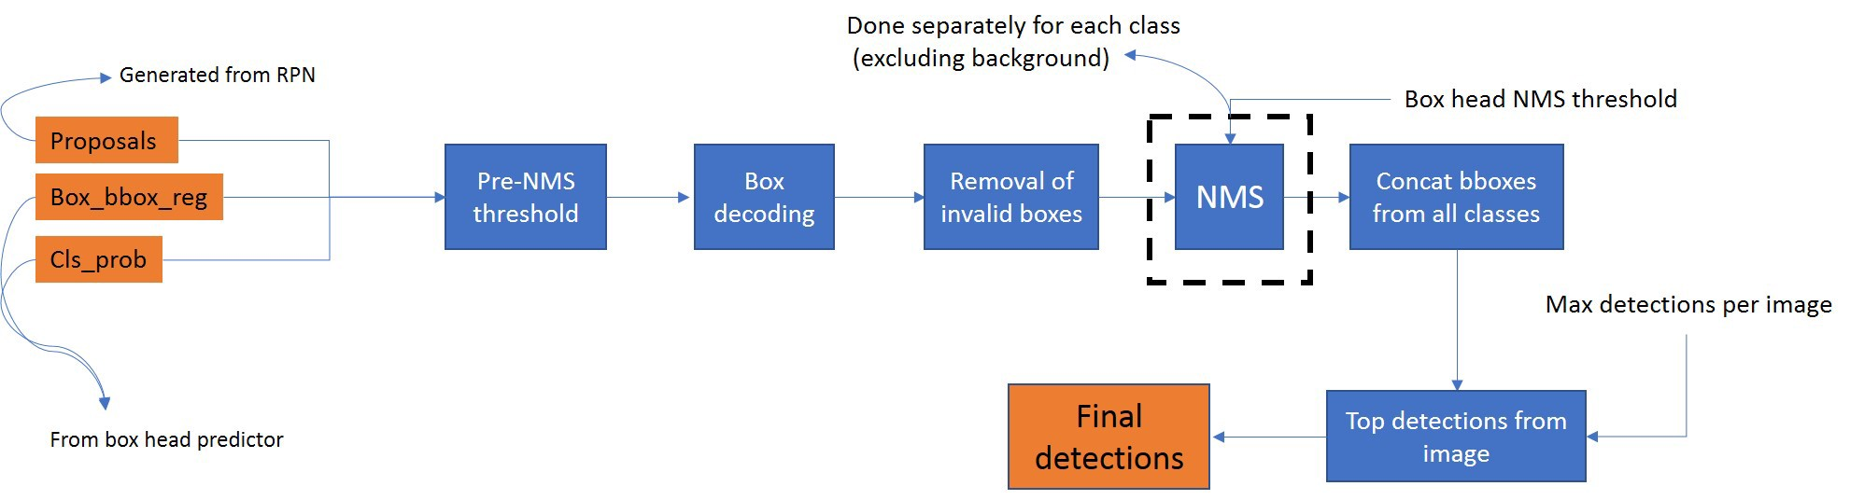
Detection:
Pre-NMS threshold: To filter the detections before NMS, based on class probability scores (default=0.5)
Decoding: Similar to what was done in case of RPN. Please note that we have box_bbox_reg values for each class separately for each proposal (eg: proposal size = [1000,4], box_bbox_reg size=[100,81(classes)*4]). We will be applying decoding step 81 times for a proposal in this example.
Removal of invalid boxes: Same as RPN.
NMS: We define a NMS threshold (default=0.5). The resultant proposals for each class are separated and NMS is done separately for each class.
Filtering top detections: The maximum detections combined for all classes in a image, i.e, there will not be detections more than this number in an image. Eg For COCO dataset, the value is set to be 100.

Slide 21
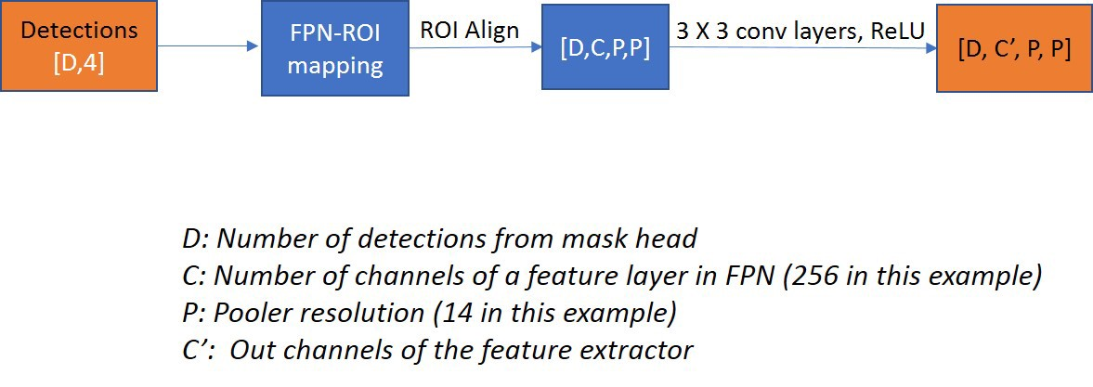
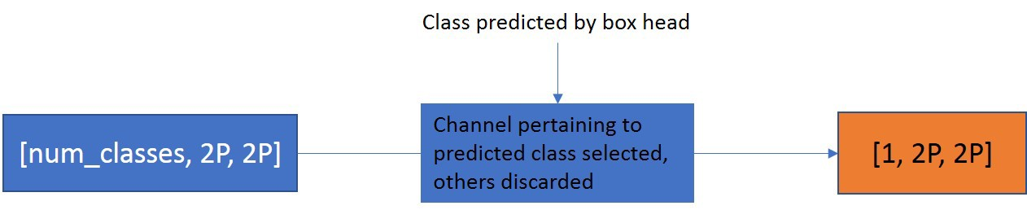
Mask Head:
I) 1)The process of feature extraction of masks is similar to box head, One key difference is the absence of fully connected layers which were present in box head as reshaping before the fully connected layers loses the spatial structure information necessary to generate masks. Like we used ROI proposals as input for box head feature extractor, we use the detected bounding boxes as an input here. The FPN ROI mapping is similar to box head again. The ROI align outputs are passed through a series of 3 X 3 convolutional layers, followed by ReLU, whose number of out channels of each layer and number of layers is a hyper parameter (for Resnet-50-FPN it is set to be (256,256,256,256)). For each detection, we get a output tensor of same dimensions as ROI align output
II) 2)he extracted features are passed through the predictor, which involves an deconv operation. This is subjected to a 1 X 1 convolutional layer, with number of out channels being equal to number of classes, one mask for each class, for each detection.
III) 3)We have already predicted the class of that detection Box head stage. Now for each proposal, we select the channel according to the class, reducing the dimensions to [D, 1, 2P, 2P].
IV) 4)The masks obtained can be resized according to the input image. The mask tensors are padded, the reason being to avoid boundary effects caused due to the up-sample (deconv) operation we had earlier. The bounding box coordinates are re-scaled according to the new mask and converted to nearest integer (The coordinates are with respect to input image). The mask is also re-scaled according to the image size, the interpolation method has been used is bi-linear. Mask threshold is a hyper parameter (default: 0.5). For each pixel, if the value is above 0.5, the object is assumed to be present in that pixel, else, absent. We finally get a [image_height, image_width] mask of the object, similarly for all the objects of image.

Slide 22
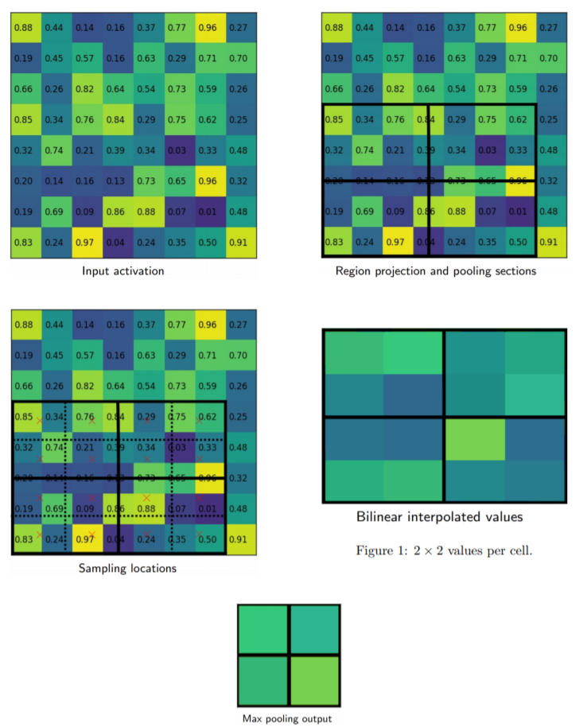
ROI Allign:
Simply put, if an N ×N output is desired, the proposed region (black rectangle in the upper-right image) is divided into an N × N grid. Unlike RoI Pooling, these regions will contain the exact same number of pixels, so we will often have fractional pixels. From each grid cell, we sample four regions as shown by the red × marks in the third image. We then subdivide each grid cell into four subcells, each centered on 3 an ×. We perform bilinear interpolation to get a single value for each subregion, or four values for each cell. These values are shown in the fourth image. Finally, we perform a simple max pooling on the bilinear interpolated values, taking the maximum value per cell to reach an N × N output. This output is then passed through the fully connected layers for bounding-box regression and classification, and through the small Fully Convolutional Network (FCN) that makes up our masking head
The Mask R-CNN research paper says that the position and number of sample points don’t matter so much.(so we can use inbuilt tensorflow function for bilinear interpolation which takes one sample)

Slide 23
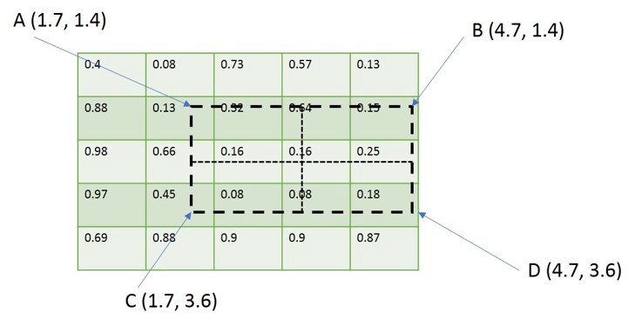
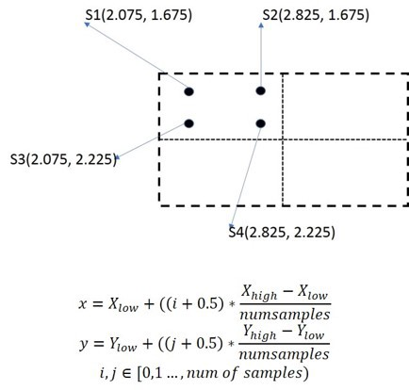
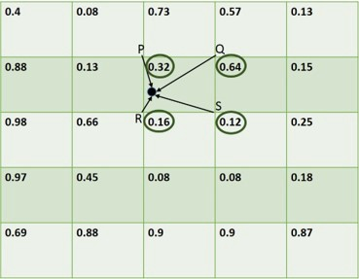
Bilnear Interpolation:
We have the same initial ROI. Notice that we DON’T perform any quantization operations, both on the ROI and the bins. The equation below explains how they have selected sample points. The value of num_samples has been taken 2 . X_low and X_high are there lowest and highest x coordinates of the bin. Using this equation we get coordinates of 4 points (S1, S2, S3, S4)
Let’s pick S1 for example, We identify 4 nearest points on feature map which match to resolution of feature map (whose coordinates will be integers). In this case P(2,1), Q(3,1), R(2,2) and S(3,2), with their respective values. Using the 4 points and the equation below, we employ bi-linear interpolation to calculate the feature value at that particular sample point. So, for S1, we get a value of 0.21778.

Slide 24
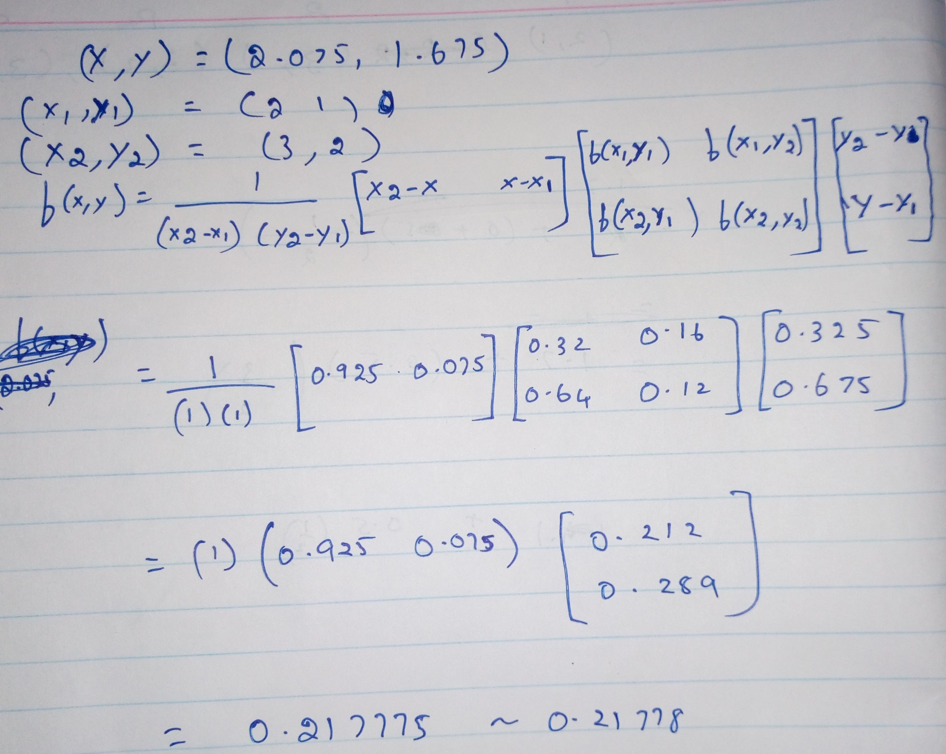
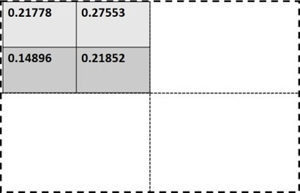
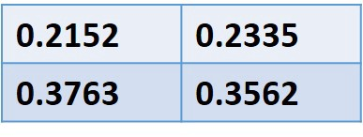
We repeat the process for other sample points, we get different values for each point. We perform average pooling for all the sample points in the bin. According to research paper, we can also use max-pool instead without any significant change in results, but they have used average pooling in their official implementation.
We repeat the process for all bins and get a final output of dimensions same for all ROI’s.

Slide 25
TODO:
Our dataset doesn’t seem to have bounding boxes. So we have to generate them manually for training and validation
Data Pre-processing( scaling, resizing, etc. of the images)
Have to build a backbone CNN model integrated with FPN. We can take Resnet-50 architecture for CNN
Have to build a RPN layer
Box and Mask head layers
And finally validation, fine tuning, evaluation, loss function and Inference
https://github.com/matterport/Mask_RCNN/blob/master/mrcnn/model.py (Use this as reference for building each layers)
So lets choose a stage for each and start working…………..

Slide 26
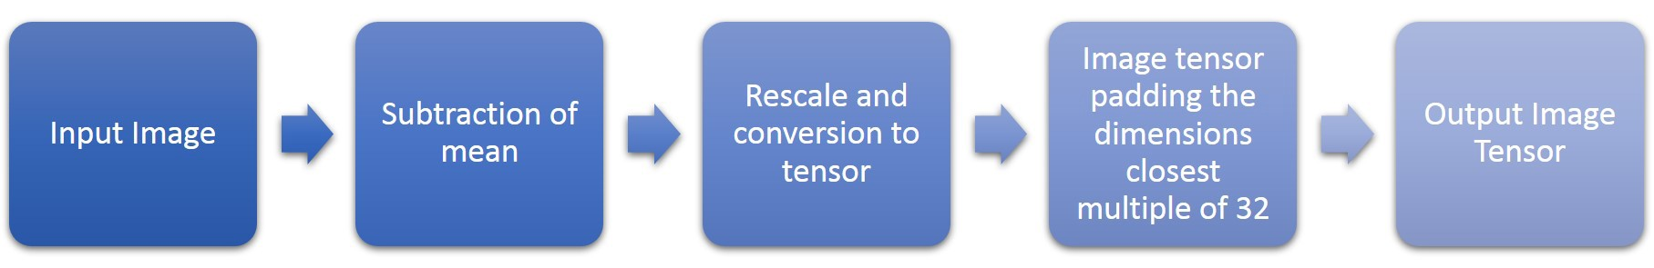
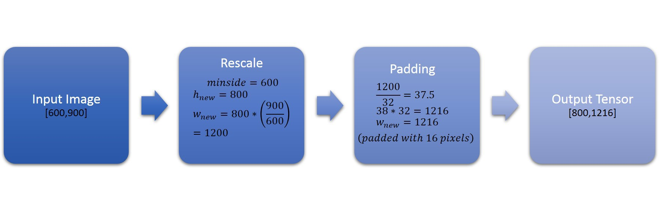
Data Pre-processing:
Subtraction of mean: The mean vector (3 X 1, corresponding to each color channel) is the mean of pixel values across all the training and test images is subtracted from the input image.
Re-scale: Two parameters are taken (target size and maximum size). The shorter side is resized to target size and longer side is resized accordingly keeping aspect ratio conserved. However, if the new value for longer side exceeds the maximum size, then longer side is resized to maximum value and resized value of shorter side changed with reference to longer side, keeping aspect ratio conserved. The default values for target size and maximum size are 800 and 1333 respectively.
Padding: It is necessary when feature pyramid networks (FPN’s) are involved (explained in the next section). All the padding is done to the right-most and bottom-most edges only, so there is no change required in coordinates of targets, as the coordinate system is based from the uppermost-left corner. This step isn’t necessary if we are not using FPN’s……..For eg..
The minimum of two sides (600) is re-scaled to 800 here and the other dimension is resized with the same scale. Since, the newly scaled side(1200) is not a multiple of 32, it is padded such that the resultant size is its multiple (1216/32=38).

Slide 27
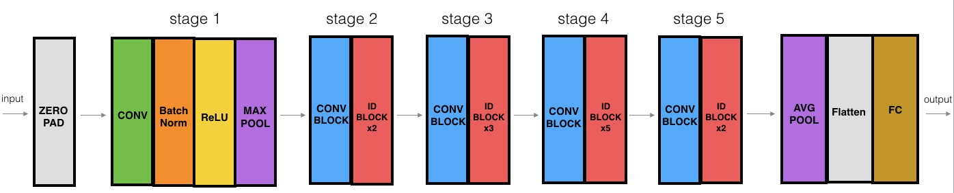
Resnet -50
https://towardsdatascience.com/understanding-and-coding-a-resnet-in-keras-446d7ff84d33 (Refer this for ID block and skip connection)

